Slide 1
Exceptions And Files
Introduced by : Aya Nasser

Slide 2
Errors
Syntax Error .
Logical Error .
Runtime Error.

Slide 3
Logical Error
Logic errors occur when there is a design flaw in your program. Common examples are:
Multiplying when you should be dividing
Adding when you should be subtracting
Opening and using data from the wrong file
Displaying the wrong message

Slide 4
Syntax Error
syntax errors represent grammar errors in the use of the programming language. Common examples are:
Misspelled variable and function names
Missing semicolons
Improperly matches parentheses, square brackets, and curly braces
Incorrect format in selection and loop statements

Slide 5
Runtime Error
Runtime errors occur when a program with no syntax errors asks the computer to do something that the computer is unable to reliably do. Common examples are:
Trying to divide by a variable that contains a value of zero
Trying to open a file that doesn't exist
There is no way for the compiler to know about these kinds of errors when the program is compiled.

Slide 6
Exceptions

Slide 7
Exceptions
They occur when something goes wrong, due to incorrect code or input. When an exception occurs, the program immediately stops.

Slide 8


Exception Examples

Slide 9


Exception Examples

Slide 10


Exception examples

Slide 11
Exceptions
Common Exceptions :
ImportError: an import fails.
IndexError: a list is indexed with an out-of-range number.
NameError: an unknown variable is used.
SyntaxError: the code can't be parsed properly.
TypeError: a function is called on a value of an inappropriate type.
ValueError: a function is called on a value of the correct type, but with an inappropriate value.

Slide 12

Runtimes Exceptions usually caused by bad programming

Slide 13
Exception handling
use a try/except statement .
The try block contains code that might throw an exception. If that exception occurs, the code in the try block stops being executed, and the code in the except block is run. If no error occurs, the code in the except block doesn't run.

Slide 14
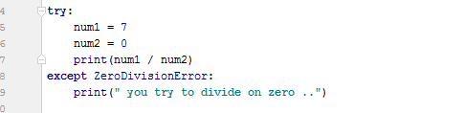

Exception handling

Slide 15
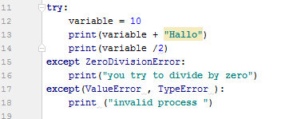

Exception Handling

Slide 16
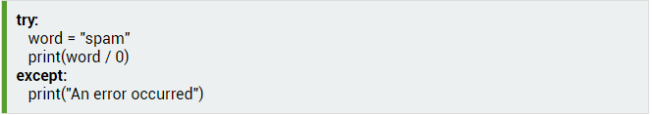
Exception handling
An except statement without any exception specified will catch all errors.

Slide 17
Finally
The finally statement is placed at the bottom of a try/except statement. Code within a finally statement always runs after execution of the code in the try, and possibly in the except, blocks.
Code in a finally statement even runs if an uncaught exception occurs in one of the preceding blocks.

Slide 18
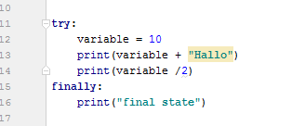
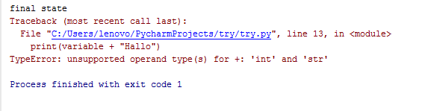
Finally

Slide 19

Raising Exception
You can raise exceptions by using the raise statement.

Slide 20

Raising Exceptions
Exceptions can be raised with arguments that give detail about them.

Slide 21

Raising Exceptions
In except blocks, the raise statement can be used without arguments to re-raise whatever exception occurred.

Slide 22
Files

Slide 23
Opening files
Myfile = open(“file path”)
Open function may take another argument “File mode”.
"r" means open in read mode, which is the default.
"w" means write mode, for rewriting the contents of a file.
"a" means append mode, for adding new content to the end of the file.
"b" to a mode opens it in binary mode, which is used for non-text files (such as image and sound files).
Notes:
The argument of the open function is the path to the file. If the file is in the same directory as the program, you can specify only its name.

Slide 24
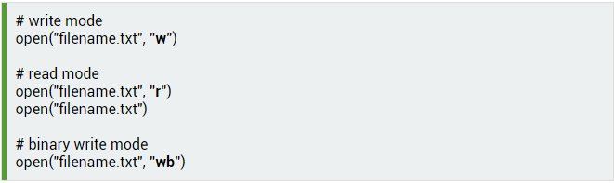
Opening files

Slide 25
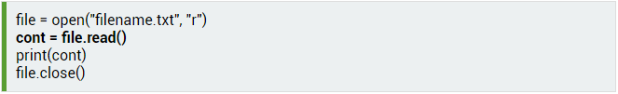
Read file
Content = read(Myfile);
Print(content)

Slide 26
Read file
To read only a certain amount of a file, you can provide a number as an argument to the read function. This determines the number of bytes that should be read.
You can make more calls to read on the same file object to read more of the file byte by byte. With no argument, read returns the rest of the file.

Slide 27
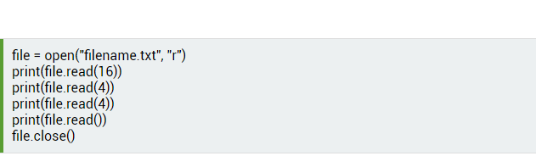
Read file

Slide 28
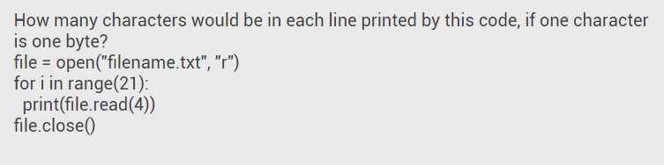
???

Slide 29

Read file
Reading line by line
Notes:
Readlines () will print all lines beside each other .
If we want to print each line in separate line
for line in file: print(line)

Slide 30

Write files
The "w" mode will create a file, if it does not already exist.
Write function my return the number of bytes stored if file if it succed

Slide 31
Write file
When a file is opened in write mode, the file's existing content is deleted.
What happens if you open a file in write mode and then immediately close it?
Notes:
What happens if you open a file in write mode and then immediately close it?
All the file contents will remove

Slide 32
File close
file = open("filename.txt", "w") # do stuff to the file file.close()

Slide 33
revesion

Slide 34
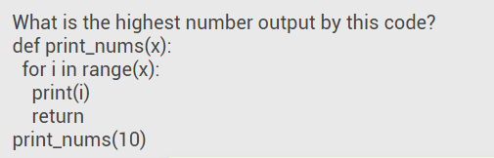

Slide 35
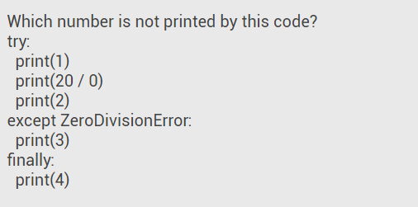

Slide 37
Any Question?!!!!

Slide 38
thank You

